Slide 1

Seasonal Crime Analysis of Chicago
Team :
Divya Kampalli
Bhavya Sirobhushanam
Venkateshwar Reddy Kasturi

Slide 2


Introduction
This presentation aims to provide an in-depth analysis of seasonal crime types and frequency in Chicago, based on historical data from 2001 to present. The insights gained from this analysis will assist city officials in making more informed decisions regarding resource allocation and policy changes to improve public safety and urban development. Understanding crime patterns and trends is crucial for effective policing and crime prevention strategies.

Slide 3
Methodology
Data Collection
The crime data was obtained from the Chicago Police Department's CLEAR system, containing information on the date, time, location, and type of crime for each reported incident from 2001 to present. R packages including data.table, ggplot2, and forecast were used for data import, manipulation, and analysis.

Slide 4
Data Preprocessing
The CSV data file was imported into R and explored to understand the structure and content.
Duplicates and missing values were handled through appropriate data preprocessing steps.
Descriptive analysis involved univariate analysis and data visualization using various plots and visualizations to reveal trends over different time intervals.

Slide 5
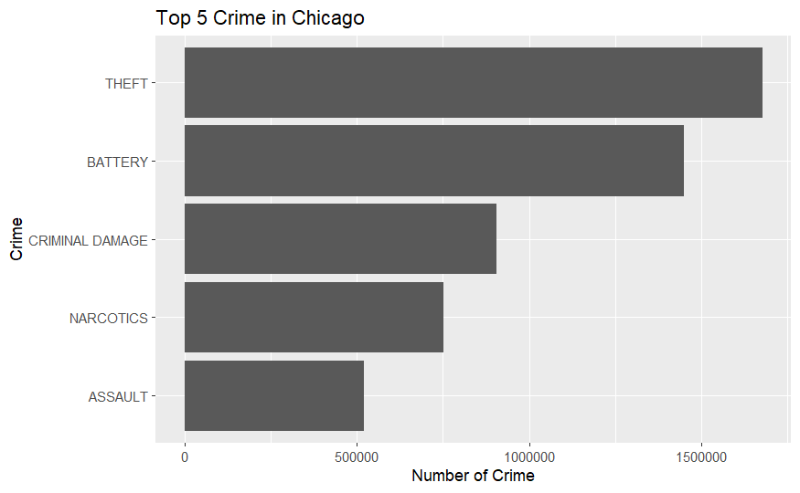
Descriptive Analysis
Analysis revealed that theft is the top crime among others.

Slide 6

Time Series Analysis
Since Theft is the highest occurring crime, we will do basic time series analysis for Theft
Below is the Decomposition of additive time series for theft

Slide 7
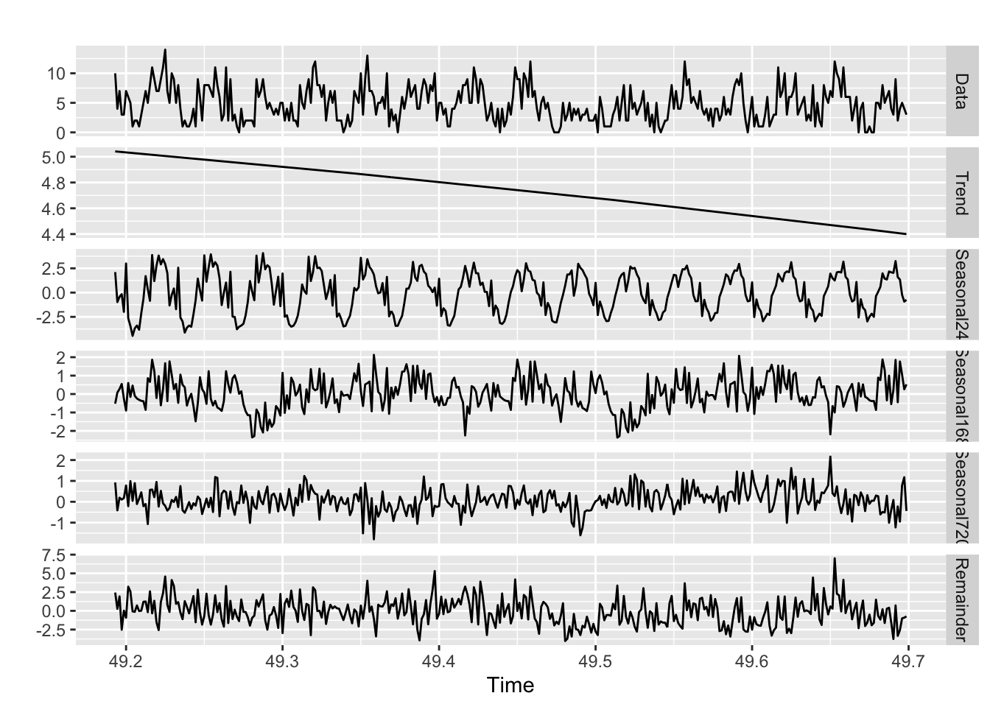
From the above graph we can see that the theft trend is decreasing over the years

Slide 8
Seasonality Analysis
Hourly, Daily, and Monthly Patterns
Hourly Seasonality
Analysis of crime rates by hour revealed peak times for theft crimes, providing valuable insights for law enforcement deployment and crime prevention strategies.
Daily Seasonality
Crime rates by day of the week showed trends of increased theft crimes on Wednesdays, Thursdays, Fridays, and Saturdays, guiding targeted law enforcement patrols and interventions. The highest crime rate is on Friday.
Monthly Seasonality
Monthly analysis revealed higher theft crime rates from June through October, highlighting the need for season-specific crime prevention measures.

Slide 9

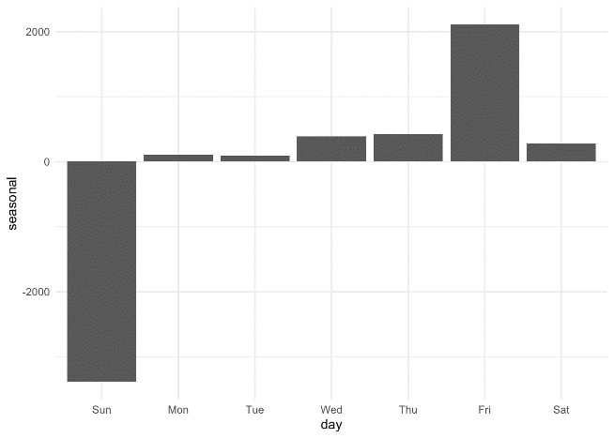
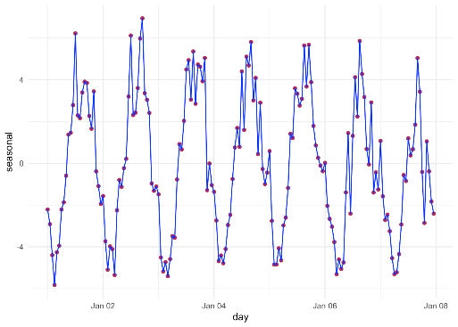


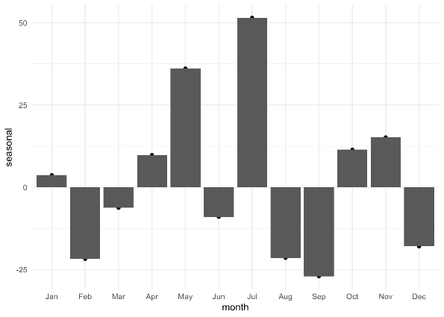

Hourly seasonality
Daily Seasonality
Monthly seasonality

Slide 10

Descriptive Analysis and Visualization
The data from 2019 to 2023 indicates a declining trend in crime rates in Chicago. It is observed that the number of crimes in the year 2020 has been dropped due to pandemic but there has been a increase in crime rates post pandemic from the year 2022.

Slide 11
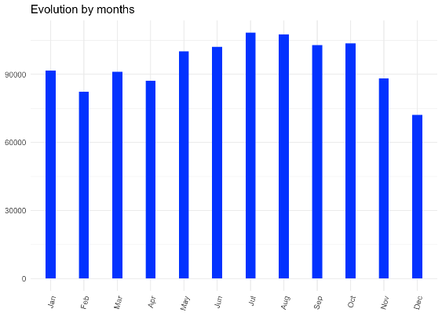
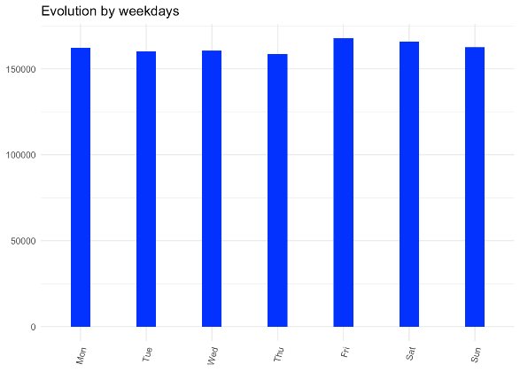
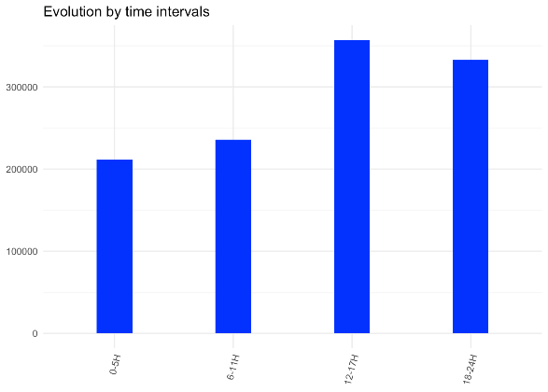
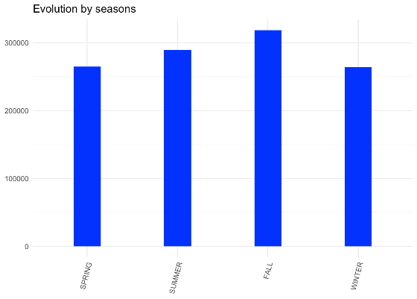
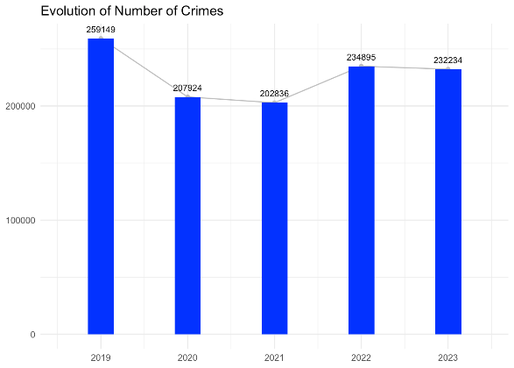

Slide 12
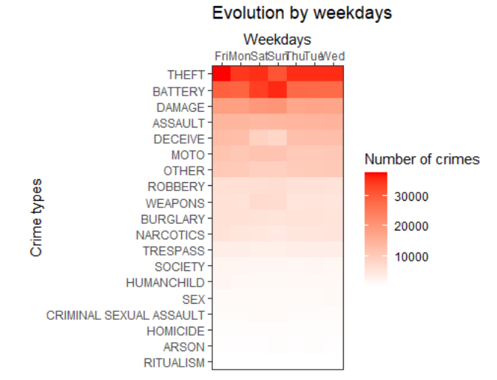
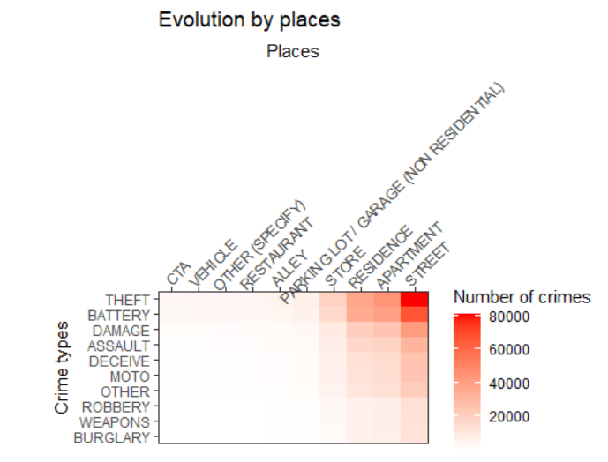
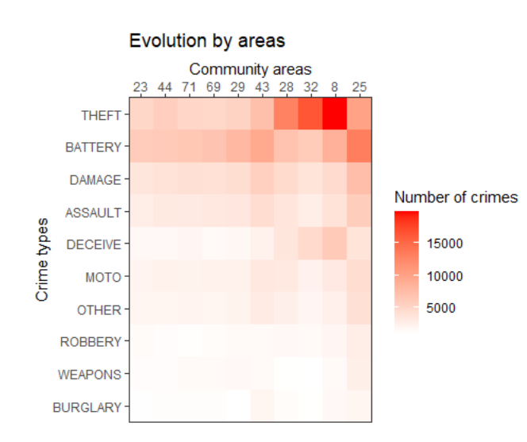
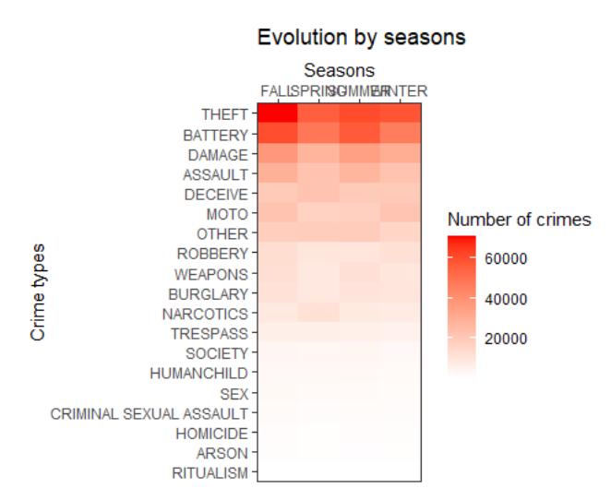
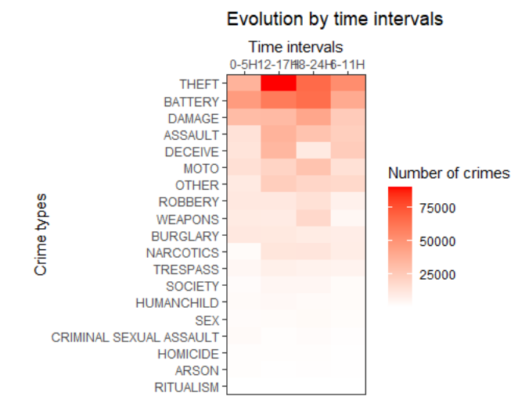
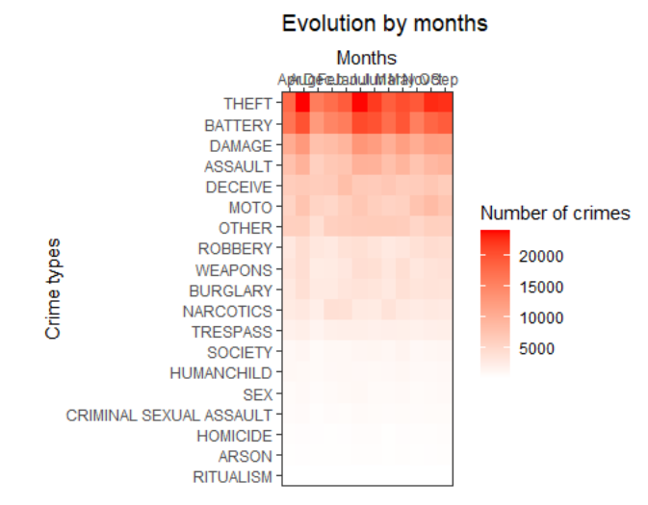

Slide 13
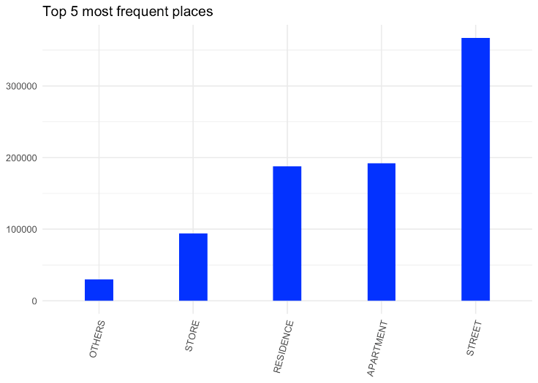
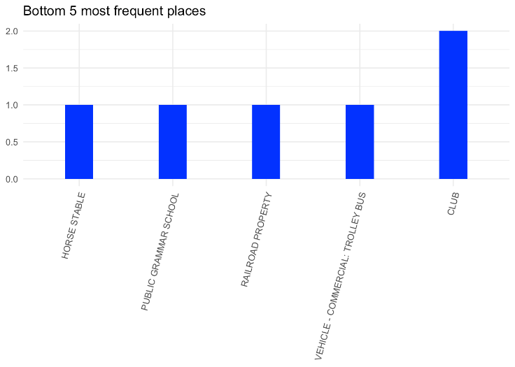
Descriptive Analysis and Visualization- By Location
The locations with highest occurrences of crime remained somewhat consistent from 2019 to 2022. Streets accounted for over 300,000 incidents - nearly triple the crimes at next top spots like apartments, residences and vehicles. While streets see all kinds of crime, further analysis revealed most vehicle crimes occur at parking locations. Retail areas witness more thefts and robberies as expected. This spatial pattern analysis again reiterates focusing policing and prevention efforts around the key hot spots.

Slide 14

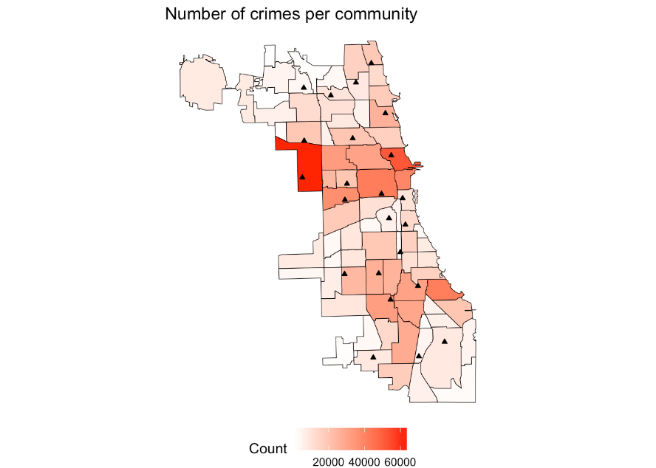
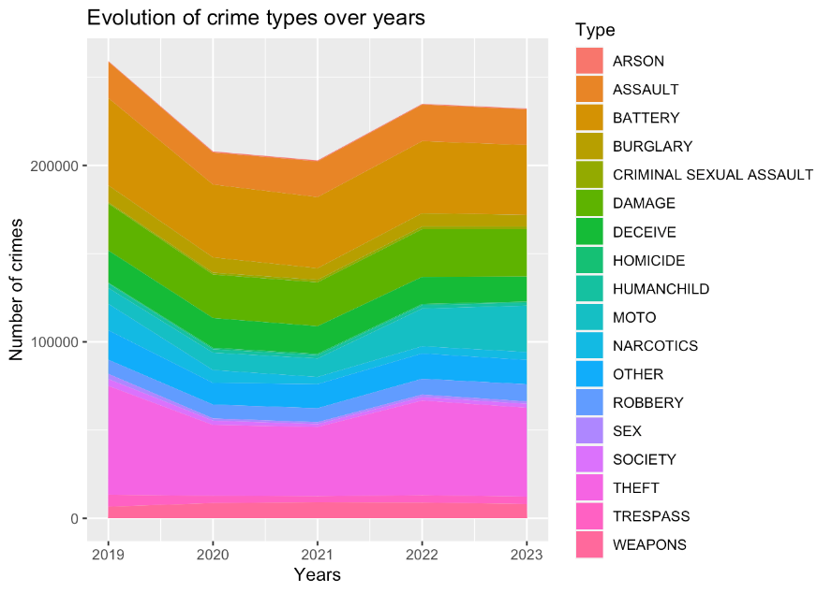
Descriptive analysis and Visualization – Community areas, Different time dimensions

Slide 15
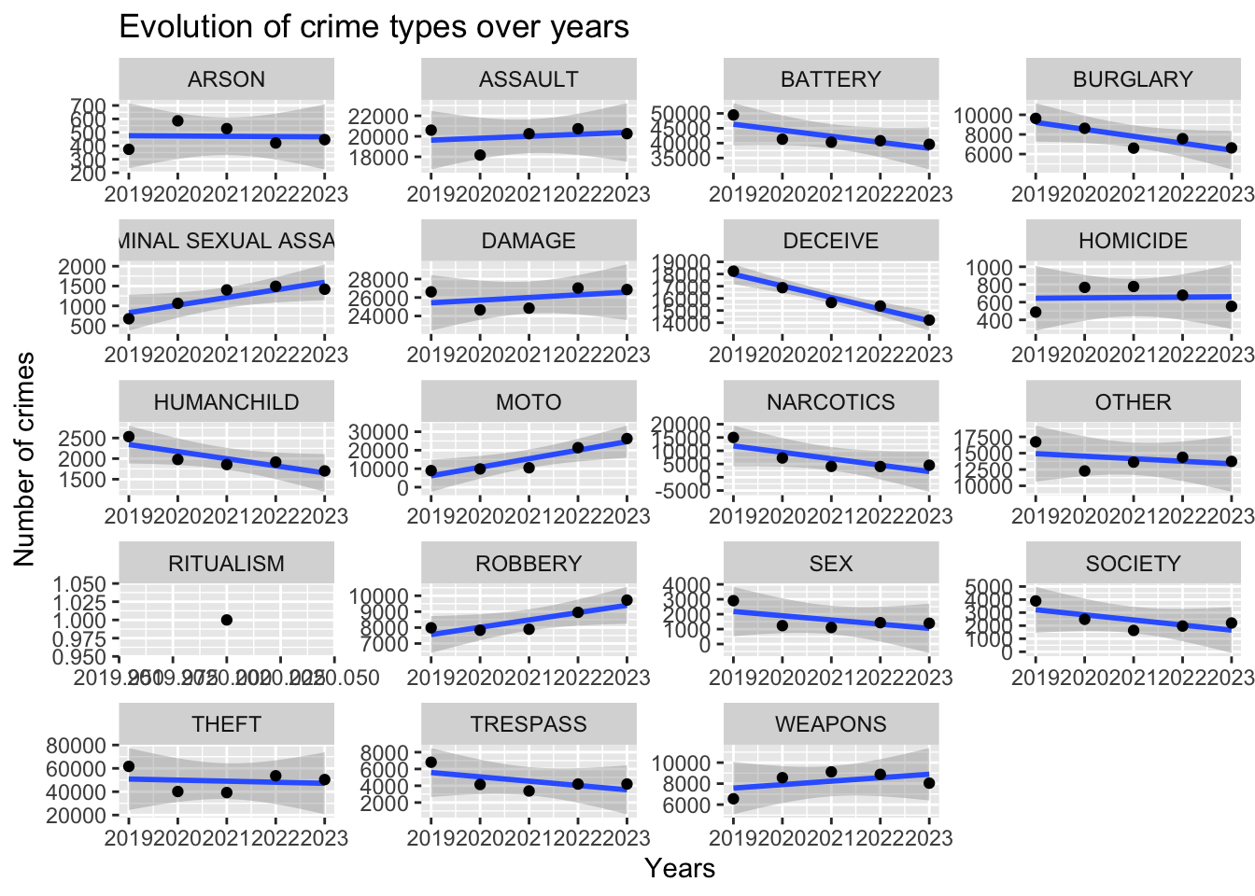

Slide 16
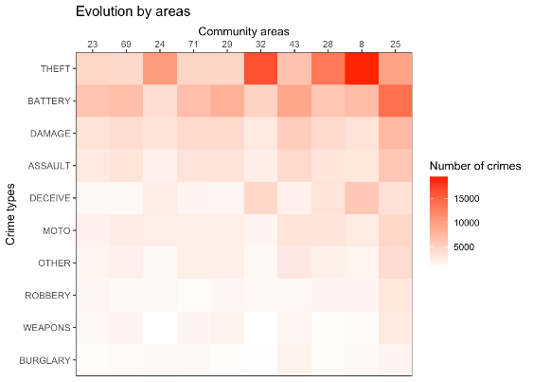
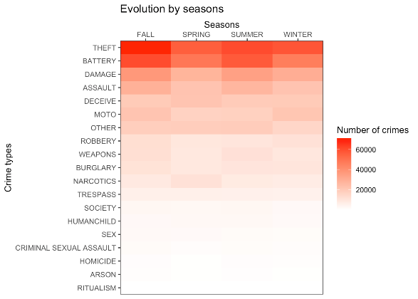
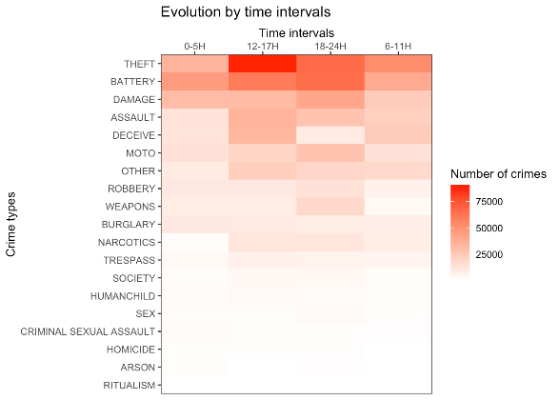
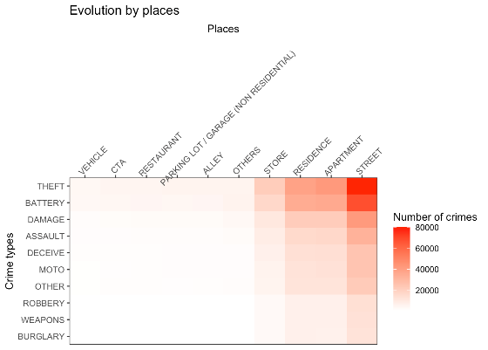
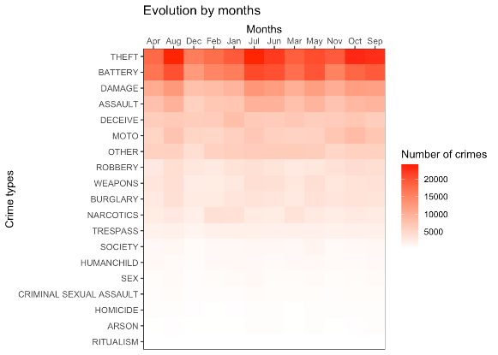
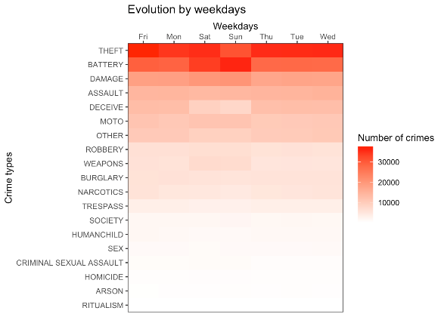

Slide 17
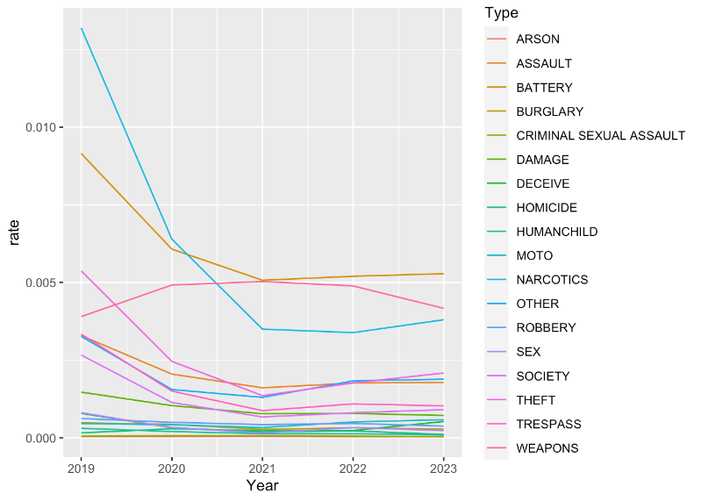
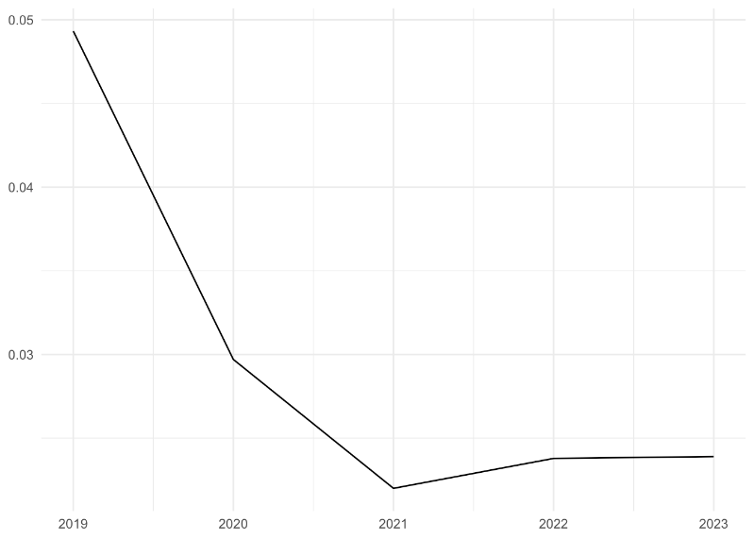
Arrest Rates
Arrest trend per crime
Arrest Rate over the years

Slide 18
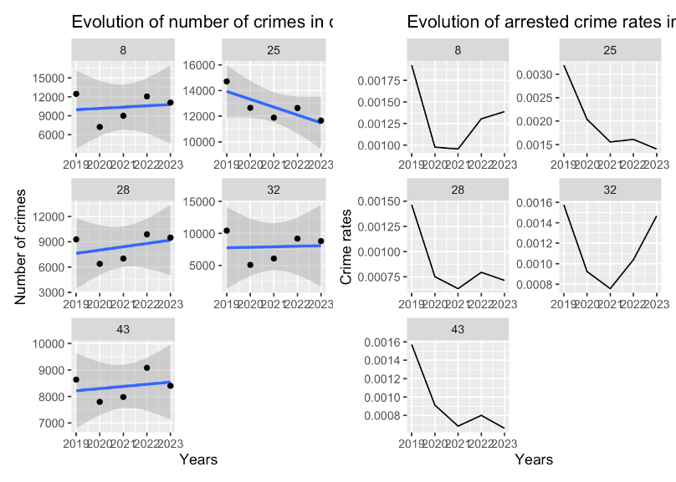
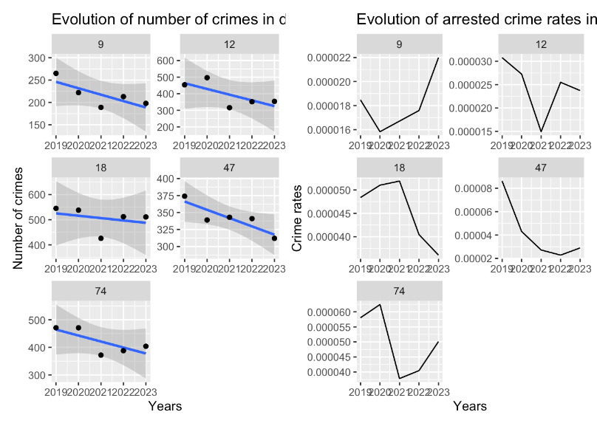
Evolution of crime types and Arrest rates By Community Areas
Crime in Top 5 Areas
Crime in least 5 Areas

Slide 19
Conclusion
Insights and Future Work
Insights
The analysis revealed insightful temporal and spatial patterns and trends for different crime types in Chicago from 2001 to present. Theft crimes showed a declining trend while assault crimes were more frequent in the summer months.
Additionally, high-crime areas and districts were identified
to guide resource deployment and prevention programs.
Future Work
Future work could involve refining time series models, incorporating additional variables like demographics and income, and developing a predictive system. Reducing and preventing crime requires a data-driven, evidence-based approach, and this analysis provides a solid foundation for further research towards making Chicago a safer city.

Slide 20

Thank You

